Slide 1
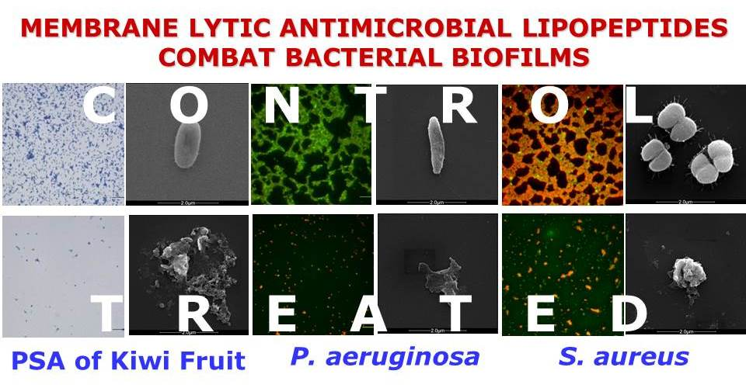
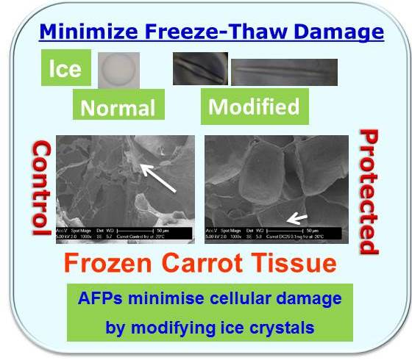
Peptide Sciences and Technologies – Turning the Tide in Medicinal Chemistry and Much More
A/Prof Viji Sarojini, School of Chemical Sciences, The University of Auckland, New Zealand
De novo designed synthetic peptides are ideal candidates for understanding protein structure and function. Structural motifs with predictable three-dimensional architecture are ideal tools for the de novo design of synthetic peptides. In many instances, synthetic peptides based on natural sequences or designed de novo also possess therapeutic potential. Particularly important in the context of the alarming increase in multidrug resistance (MDR) are antimicrobial lipopeptides that provide alternatives to conventional antibiotics.
Research in the Sarojini group focusses on both fundamental and applied aspects of Peptide Science. This talk will summarise our research on 1) antimicrobial lipopeptides that eradicate biofilms, 2) synthetic antifreeze peptides that minimize freeze-thaw damage in frozen foods, 3) novel β-turn mimics that facilitate the syntheses of cyclic tetrapeptides and 4) self-assembling peptide hydrogels.
De Zoysa et al. J. Med. Chem. 2015, 625
Cameron et al. J. Med. Chem. 2017
10.1021/acs.jmedchem.7b00953
Kong, et al. J. Agric. Food Chem. 2016, 4327

Slide 2
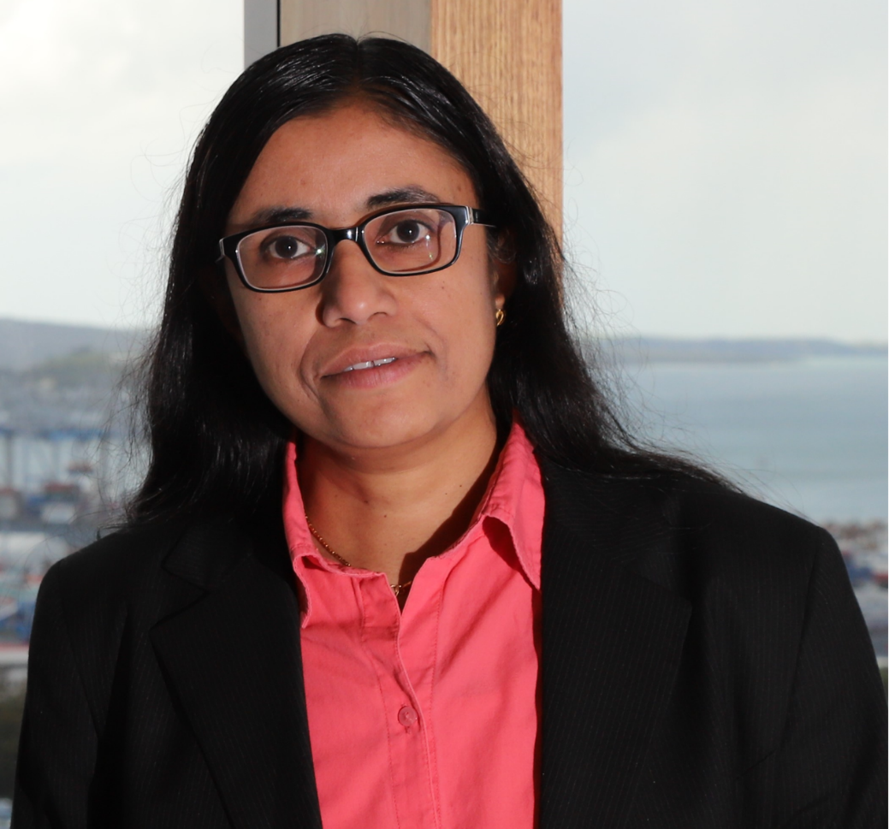
A/Prof Viji Sarojini
School of Chemical Sciences, The University of Auckland, Auckland, New Zealand
Dr Sarojini obtained her PhD in Peptide Chemistry working with Profs. P. Balaram and R.B Rao at the Indian Institute of Science, Bangalore and BHU, Varanasi India which was followed by postdoctoral research at Linkoping University, Swe­den; University of Leeds, UK and Texas A & M University, USA. Moving to New Zealand in 2004, she joined Plant and Food Research and worked on Bioactive Peptide solutions for bacterial diseases of plants. She joined the University of Auckland in 2006 where she currently holds the positon of Associate Professor in Chemistry and is also one of the Deputy Directors of the Centre for Green Chemical Science. She leads a group of several PhD students and postdocs in fundamental and applied aspects of Peptide Chemistry, which include the applications of Peptides in Food, Drug, Health and Energy Domains. She is passionate about equity and inclusion of underrepresented groups in Higher Education and Research and has got interested in the Kindness in Science Movement that originated in New Zealand recently.

