Slide 1
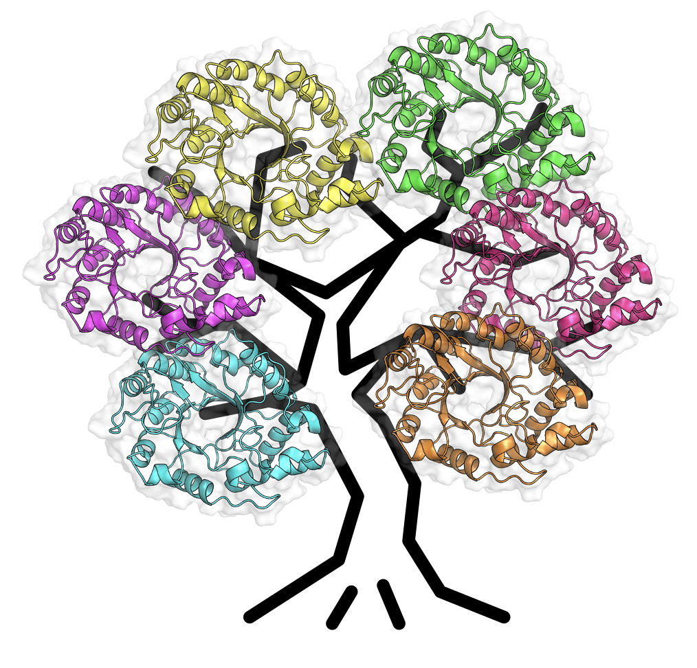
L’EDI : Qu’est-ce que c’est ? Et pourquoi est-ce important ?
EDI: What is it? And why should I care?
Participative workshop created by
Claudèle Lemay-Denis, PhD candidate in biochemistry (U. de Montréal) and
Rojo Rakotoharisoa, PhD candidate in chemistry (U. of Ottawa)
For the Chemistry department, U. de Montréal
June 3rd, 2022

Slide 2
Learning objectives
Recognize the types of diversities and their importance in academia
Being aware of disparities in academia
Familiarizing with unconscious biases
Discuss our experiences and feasible solutions for improving inclusion and diversity in the academia

Slide 3
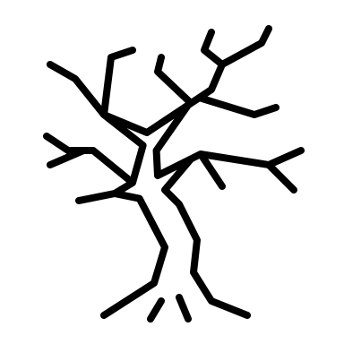
Diversity
Age
Neurodiversity
Ethnicity
Physical ability
Religion
Socioeconomical background
Race
Sexual orientation
Gender

Slide 4
Equity, Diversity and Inclusion
in Science
Innovation and creativity are key in scientific research
Diversity enhances excellence and innovation
AlShebli et al, Nat Comm, 2018
Freeman and Huang, Nature, 2014
Swarts et al, J. Infect. Dis., 2019

Slide 5
Equity, Diversity and Inclusion
in Science
Equity is about creating fair access, opportunity, and advancement for a diversity of people
Inclusion refers to creating an environment where all people are respected and valued equally, and have a sense of belonging.

Slide 6
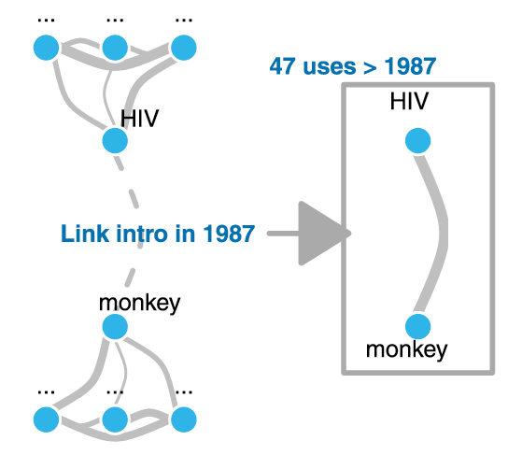
Minorities Introduce Novelty
Lilian Bruch
The less a student is represented in their group, the less their ideas are valued or heard
Novelty is linking two concepts that had yet to be connected
Purification of Simian T-cell Lymphotropic virus-III and a Comparison with Human Immunodeficiency Virus (1987)
Hofstra et al, PNAS, 2020

Slide 7
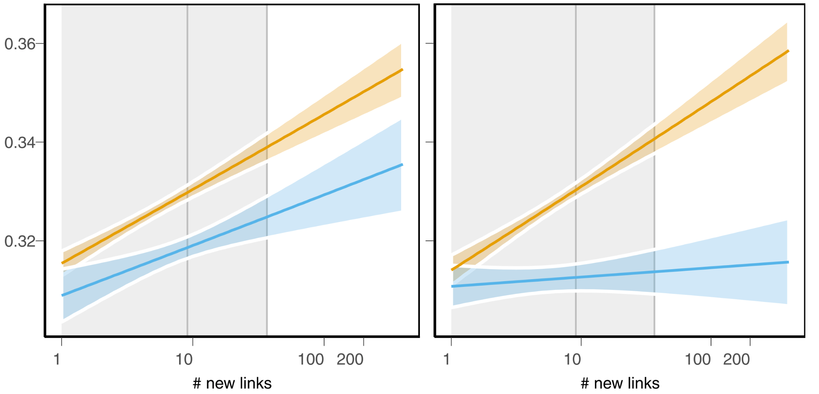
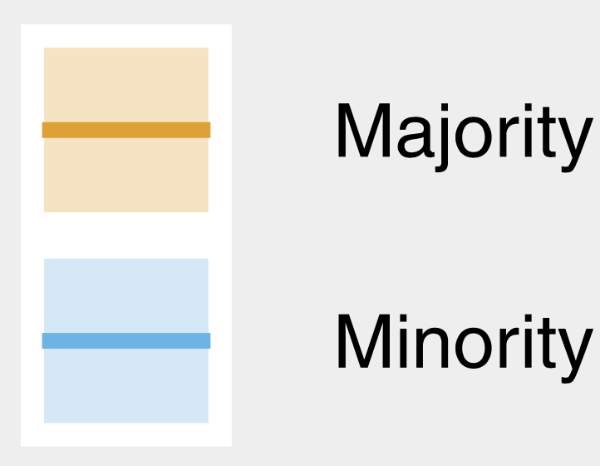
Paradox of Diversity-Innovation
Based on gender
Based on race
Probability of continuing research
200
200
Novelty
Novelty
Hofstra et al, PNAS, 2020

Slide 8
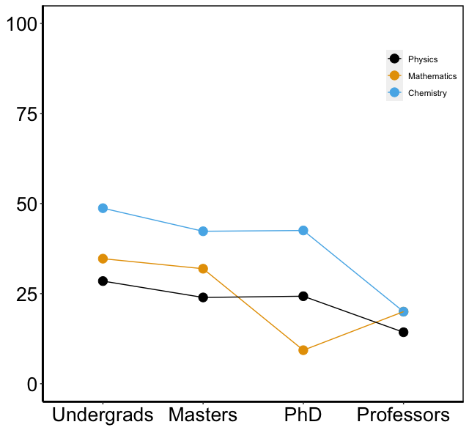
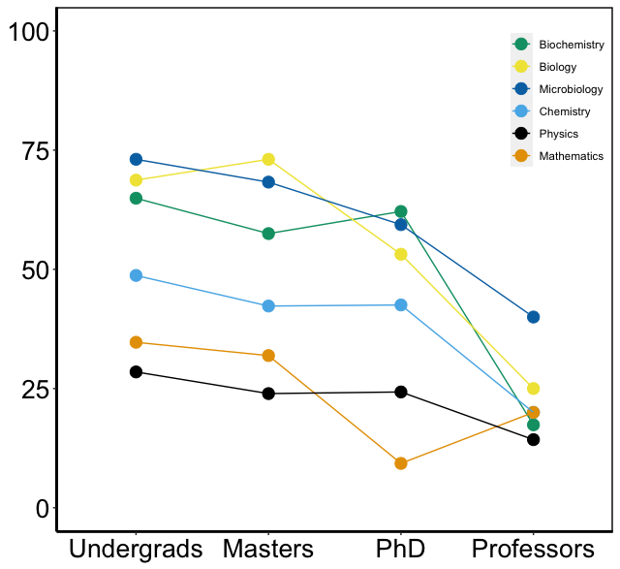
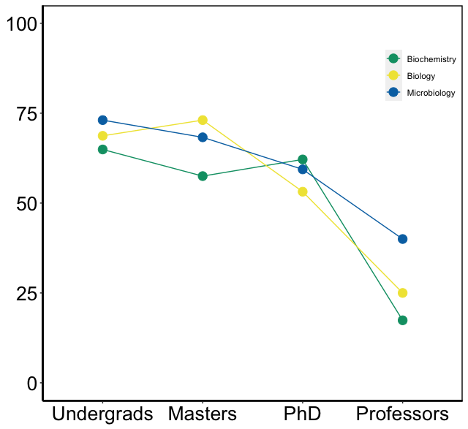
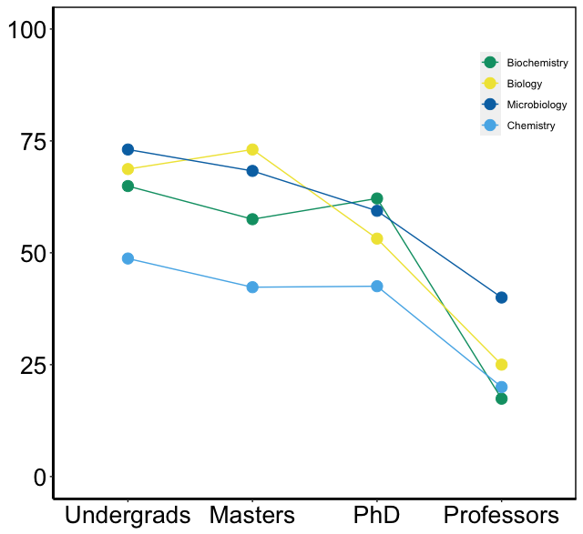
About Continuing in Research
Université de Montréal, 2020
Biochemistry
Biology
Microbiology
Chemistry
Physics
Mathematics
Percentage of women
53 ± 19 %
50 ± 20 %
42 ± 21 %
23 ± 9 %

Slide 9
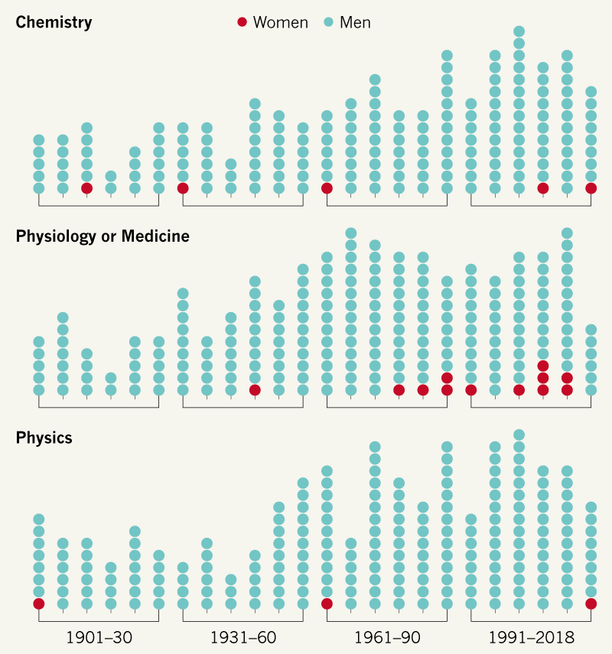
Recognition
7/188
Marie Skłodowska-Curie
12/224
3.6%
0%
23 out of the 631 Nobel medals in scientific disciplines were awarded to women
0 out of the 631 Nobel medals
in scientific disciplines were awarded to black and/or
queer scientists
4/219
Marie Skłodowska-Curie
E. Gibney, Nature, 2019

Slide 10
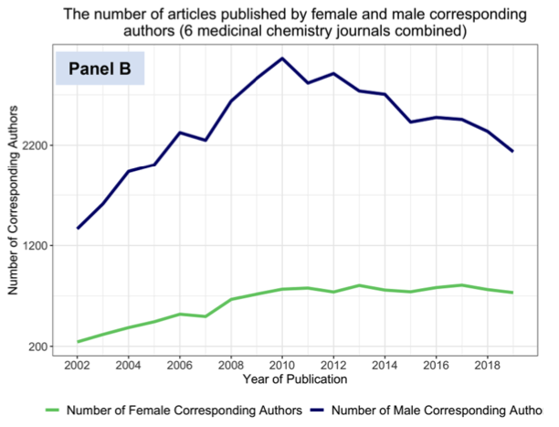
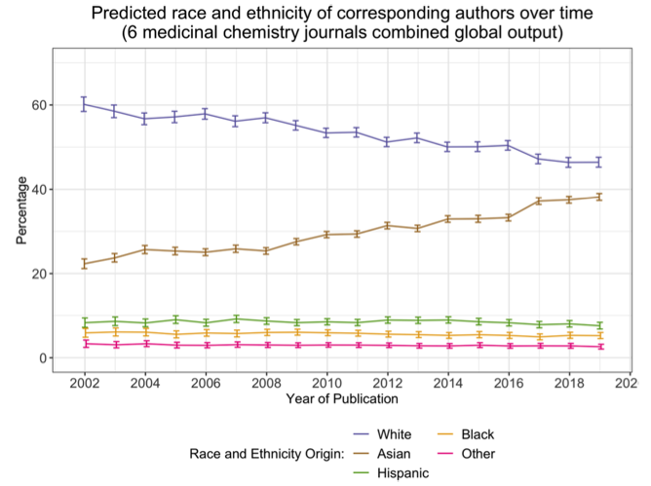
Are things changing?
According to publications in medicinal chemistry journals over the last 20 years…
Number of articles published according to the corresponding author’s gender over time
Predicted race and ethnicity of the
corresponding authors over time
White Asian Hispanic Black Other
Male
Female
Number of corresponding author
Percentage
Year of publication
Year of publication
Hatley et al, J. Med. Chem., 2021

Slide 11
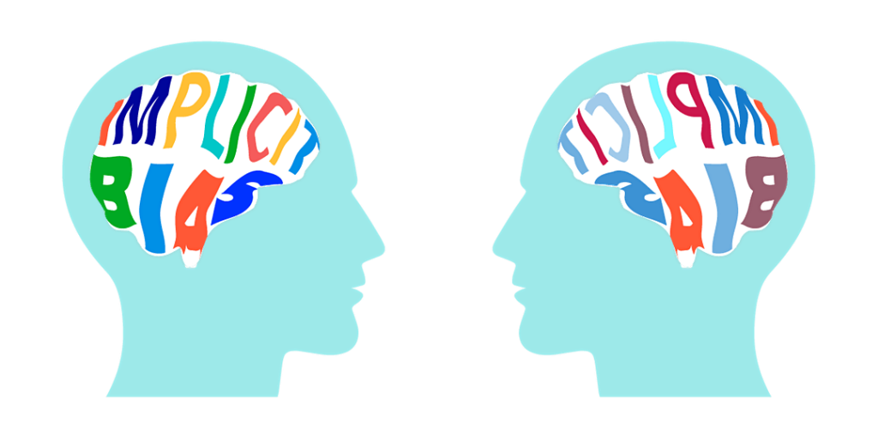
Unconscious Biases
Automatic, mental shortcut used to process information and make decisions quickly
Learned from our environments, education, and culture
Can lead to errors: negative stereotypes, prejudices toward marginalized groups
https://tll.mit.edu/teaching-resources/inclusive-classroom/implicit-bias/

Slide 12
Challenges in Recruitment
CV and interviews:
Uncommon names and accents are viewed negatively
Be aware of potential biases
Clearly define important criteria for a position
Acknowledge expertise gained from Non-English environments
Cotton et al., Journal of Managerial Psychology, 2008

Slide 13
Concept of Excellence
How do we value excellence in academia?
Typical path or atypical path
Innate intelligence rather than hardworking and dedication
Inclusive notion of excellence
values a range of skills
acknowledges alternative career paths, commitments outside of academia
How alternative path enriched their professional skills
Lewis et al., Physical Review Physics Education Research, 2010

Slide 14
Recommendation letter
Some facts
People write better recommendation letters to those who are similar to them
Recommendation letters written for men are in average 16% longer than for women
Adjectives used to describe men and women are different
Men are excellent and accomplished
Women are hard-working, organized
White people are more susceptible to be described as outstanding, exceptional and best than black, Asian, and Hispanic people.
What can you do?
Make sure to address all evaluation criteria
Do not use stereotypical characteristics
Do not include characteristics that can be considered as discriminatory
Favour epicene writing from the beginning of the writing process
Eger, Doctoral thesis, 1991
Trix and Psenka, Discourse & Society, 2003
Ross et al. PLoS ONE, 2017
Chaire pour les femmes en sciences et en génie au Québec (Eve Langelier): https://cfsg.espaceweb.usherbrooke.ca

Slide 15
Grant/Scholarship applications
Integrating the value of EDI in your research
Present how you educate yourself on EDI issues in academia
Participate in workshops on EDI
Implement concrete actions to increase inclusion in the team
Epicene writing
Value your engagement in your community
Association, mentorship, volunteering
Scientific outreach
https://capcampus.umontreal.ca : 1000 sciences
Highlight your atypical path to academia: positive impact on your career development

Slide 16
Grant applications
Integrating the value of EDI in our workspace
Team composition and trainee recruitment processes
Present concrete actions showing that EDI is intentionally and proactively considered when recruiting new members
Equitable, inclusive and accessible research work environment
Indicate concrete practices to ensure that all are fully involved and supported in the research team
Diversity and equity in mentoring, training and access to development opportunities
Providing a diversity of role models and mentors
Ensuring that training and development opportunities are available to all trainees
CRSH

Slide 17
Microaggressions
Microassault
“Really, it’s ridiculous that anyone believes in God, you can’t be a real scientist if you believe in God.”
Microinsult
“A plain white lab coat? But you’re gay, so your lab coat should be fabulous!”
“Wow, your English is so good!”
Microinvalidation
“I don’t believe Dr. Doe was being racist with his comments, you’re blowing this out of proportion.”
“Don’t be so sensitive”
How can one concentrate on their professional and academic responsibilities when their individual’s sense of belonging, self-efficacy, and science identity is invalidated?
What if we are the ones invalidating someone else, even with the best intentions?
Harrison and Tanner, Biol. Teach. Learn., 2018

Slide 18
No, I am not transphobic, I have a trans friend.
Where are you really from?
She only got the job because she is a black woman.
I would’ve never guessed you were gay!
Feel free to bring your wife!
What can you do?
Recipient
Offender
Witness
- It’s not your job to teach
- Respond if you feel safe
- Keep context in mind
- Criticize the act, not the person
- Reach out for support
- Accept responsibility
- Try not to be offensive
- An heartfelt apology is
a critical first step
- Work to raise your own awareness
- Intent does not equal impact
- Be an ally
- Speak for yourself, not the recipient of the microaggression
- Develop and practice responses
- Check in with the recipient
- Report the incident
ACS webinar 2020, F Dainkeh and P Christopher

Slide 19
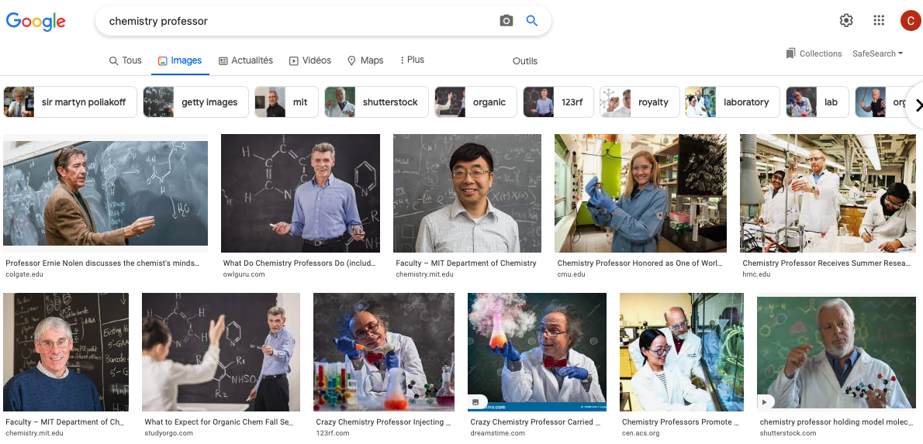

Slide 20
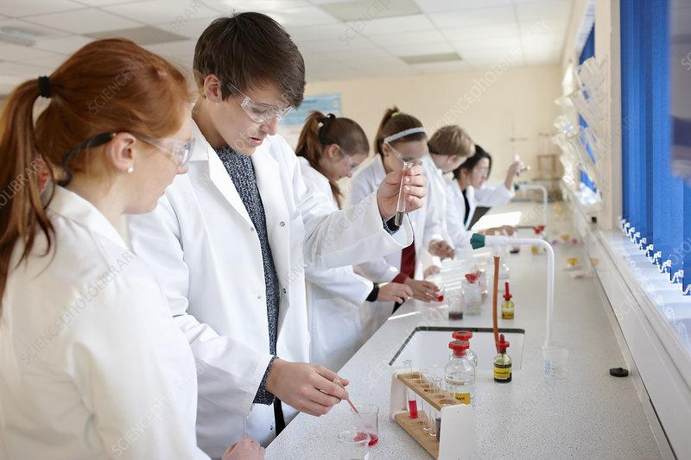
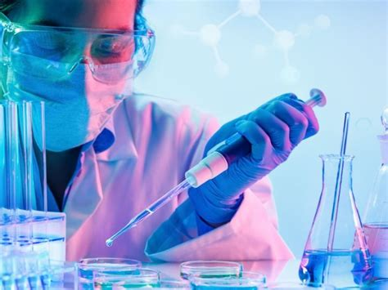
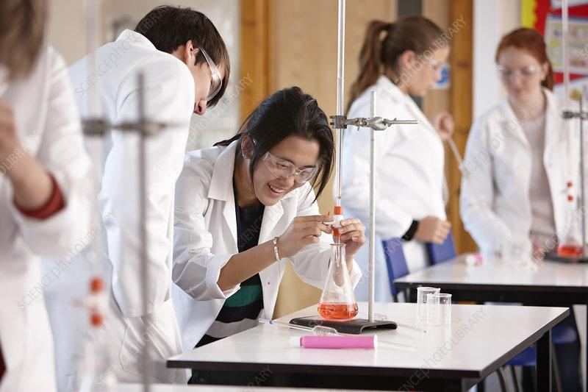
The Power of Representation
In 10 current (2016-2020) US college-level general chemistry texbooks:
A male name appears every 4 pages of text
A female name appears every 250 pages of text
Yet:
Female students had higher comprehension after viewing female scientists than after viewing male scientists.
Male students had higher comprehension after viewing male scientists than after viewing female scientists images.
Disadvantage to female students
Becker and Nilsson, J. Chem. Educ., 2021
Good, J. Soc. Psychol., 2010

Slide 21
Challenges of Representation
Recruitment
Retention
Goal: Improve marginalized group performance and sense of belonging
Difficulty: stereotype threat which leads to underperformance
Goal: Attract more diversity in the field
Difficulty: less attractivity when a field is associated with a stereotype
Need for changing the stereotype associated with the field
Lewis et al., Physical Review Physics Education Research, 2010
Drury et al., Psychology Press, 2011

Slide 22
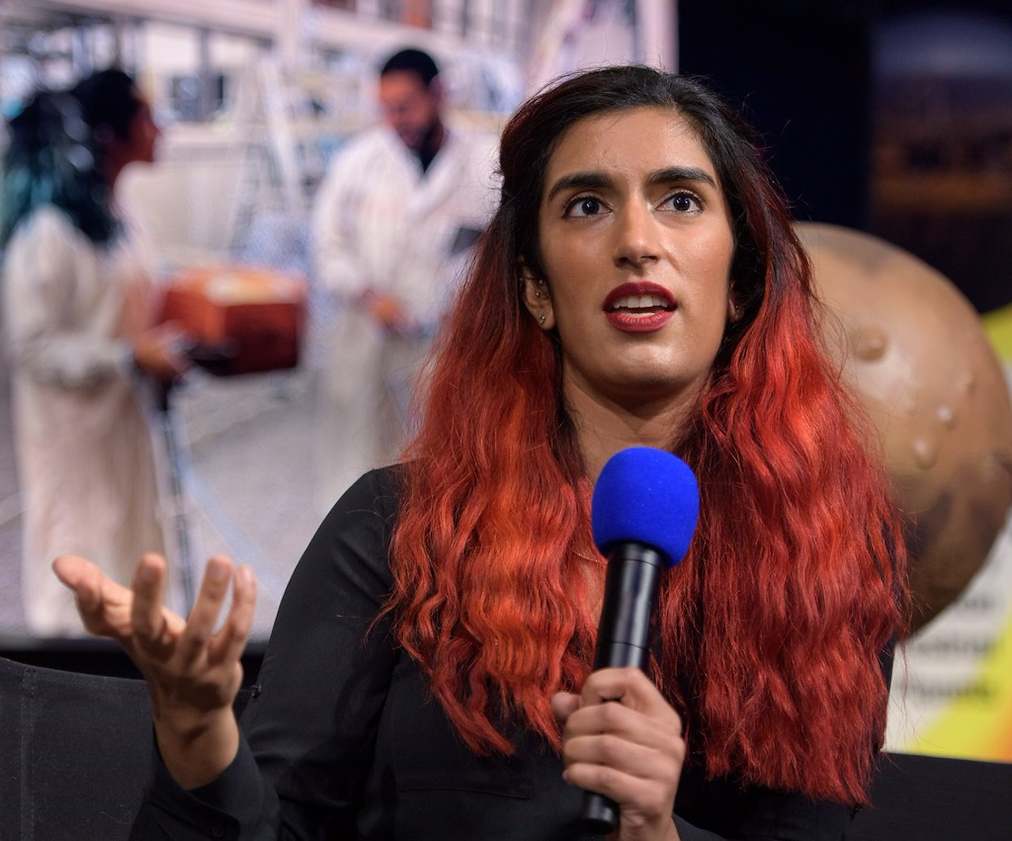
The Power of Representation
Canadian-Malagasy, from Montréal
LGBTQ+ immigrant woman of color
Masters at Cambridge, PhD at MIT
Leader of an Ingenuity team at NASA
Inspired by the first female Canadian astronaut
Inspires the next generation of scientists
Farah Alibay
What can you do?
Be a mentor for the next generation of scientists, and encourage them to develop their passion

Slide 23
Conclusions
For Science to be the most innovative, it must be led by a diverse group of scientists
Academia is currently not sufficiently inclusive of all types of diversity
Everyone is not given the same opportunities which can have long lasting impacts on careers
Interpersonal interactions contribute to our scientific development
We can, and we need to, change this

Slide 24
Let’s discuss!

Slide 25
Recognition
Microaggressions
How do you feel about the content we showed you?
Diversity of identities
Unconscious
biais
Representation
in science

Slide 26
People from marginalized groups suffer from negative stereotypes.
Sometimes, they may identify with those negative stereotypes.
In your opinion how could we promote inclusion for marginalized groups?

Slide 27
Have you experienced a situation in which you or someone else was victim of a microaggression?
Would you be comfortable to share it?
Can you remember performing a microaggression?

Slide 28
We have seen that representation helps to promote recruitment and retention among the people from marginalized groups.
In your opinion what can the chemistry department implement to improve representation?

Slide 29
Recognition
Microaggressions
What are the key points you will retained?
Diversity of identities
Unconscious
biais
Representation
in science

Slide 30
What would be the ideal circumstances and work environments that would allow you to thrive as students, research professionals or faculty?
Could some of these be implemented?

Slide 31
Resources
Articles
AlShebli et al, Nat Comm, 2018
Freeman and Huang, Nature, 2014
Swarts et al, J. Infect. Dis., 2019
Hofstra et al, PNAS, 2020
E. Gibney, Nature, 2019
Hatley et al, J. Med. Chem., 2021
Cotton et al., Journal of Managerial Psychology, 2008
Lewis et al., Physical Review Physics Education Research, 2010
Eger, Doctoral thesis, 1991
Trix and Psenka, Discourse & Society, 2003
Ross et al. PLoS ONE, 2017
Harrison and Tanner, Biol. Teach. Learn., 2018
Becker and Nilsson, J. Chem. Educ., 2021
Good, J. Soc. Psychol., 2010
Lewis et al., Physical Review Physics Education Research, 2010
Drury et al., Psychology Press, 2011
Websites:
Implicit Biases: https://tll.mit.edu/teaching-resources/inclusive-classroom/implicit-bias/
Chaire pour les femmes en sciences et en génie au Québec: https://cfsg.espaceweb.usherbrooke.ca
1000 sciences: https://capcampus.umontreal.ca
Webinar:
ACS webinar 2020, F Dainkeh and P Christopher

